Slide 1
Thanks to Almighty !!!

Slide 2

Priyatharshini Sundaram
Software Engineer III @PayPal
Microsoft Certified Trainer(MCT-2019 to 2023)
Certified Multi-cloud Architect(6X Azure Certified, 1X GCP Certified)
https://www.linkedin.com/in/priyatharshini-s-75b002110/

Slide 3
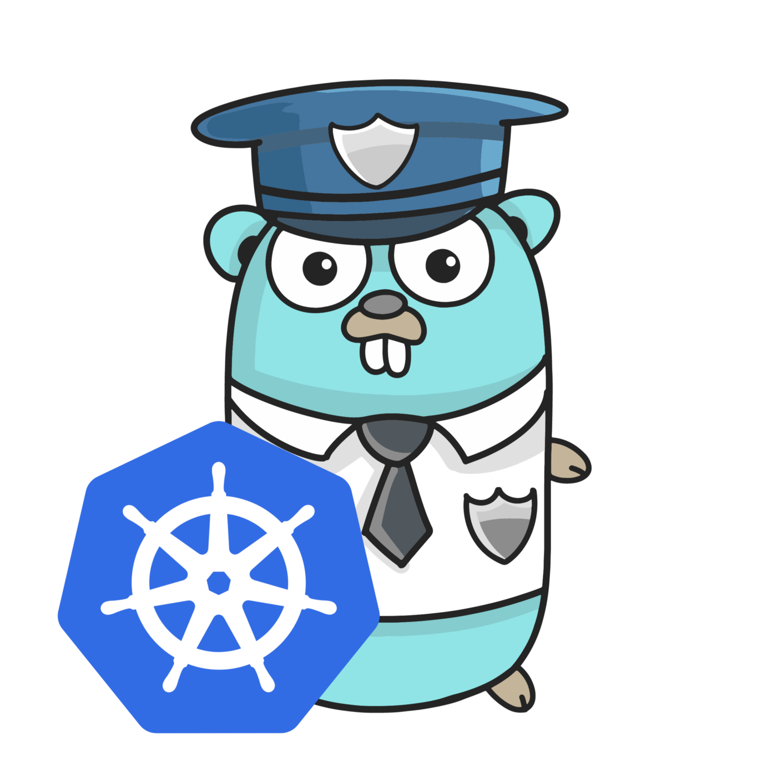
Automate Azure Kubernetes Service with Golang
Lets Explore how to deploy Golang service in AKS & Create Azure services
using Golang SDK

Slide 4
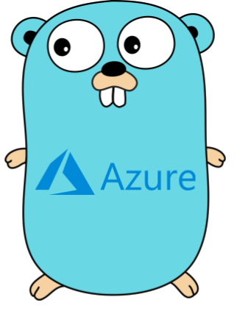
What we cover today :
Why Golang ?
What is Golang ?
When to use Golang ?
Demo - Deploy Golang App as Service on AKS
Overview of Azure Golang SDKs
Demo – Simple App to Provision Azure Service using Azure Golang SDK

Slide 5

Why GoLang ?

Slide 6
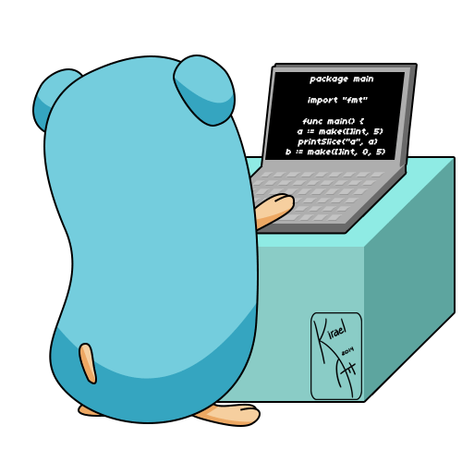
What is Golang ?
Young system programming language (It’s open-source)
it’s a new-age(2k born) language with immense speed.
It comes with inbuilt support for applications distributed on a multi-core network.
Golang Is Simple, Fast ,Scalable & Easy To Learn
Ease of concurrency (has Go-routine)
Incredibly fast performance & richness of library
Easy compilation & support garbage collection
Let’s Go

Slide 7
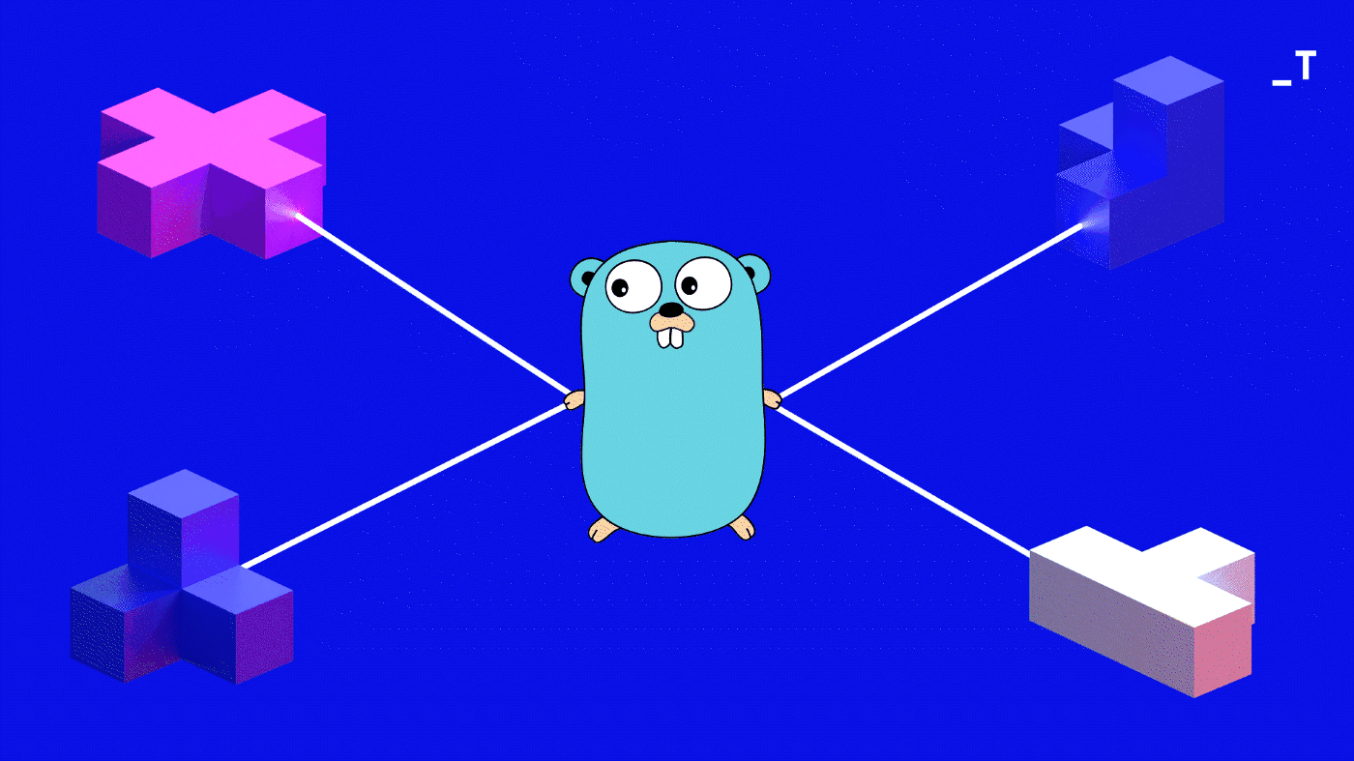
When to use Golang ?
Cloud Designing & Infrastructure
Real-time Applications Development
Networking Development
Microservices
Cloud Designing & Infrastructure
Real-time Applications Development
Networking Development
Microservices

Slide 8

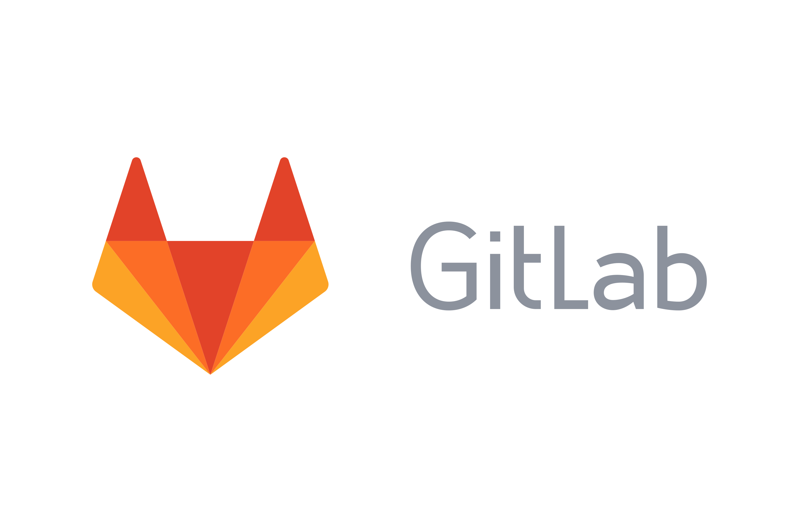
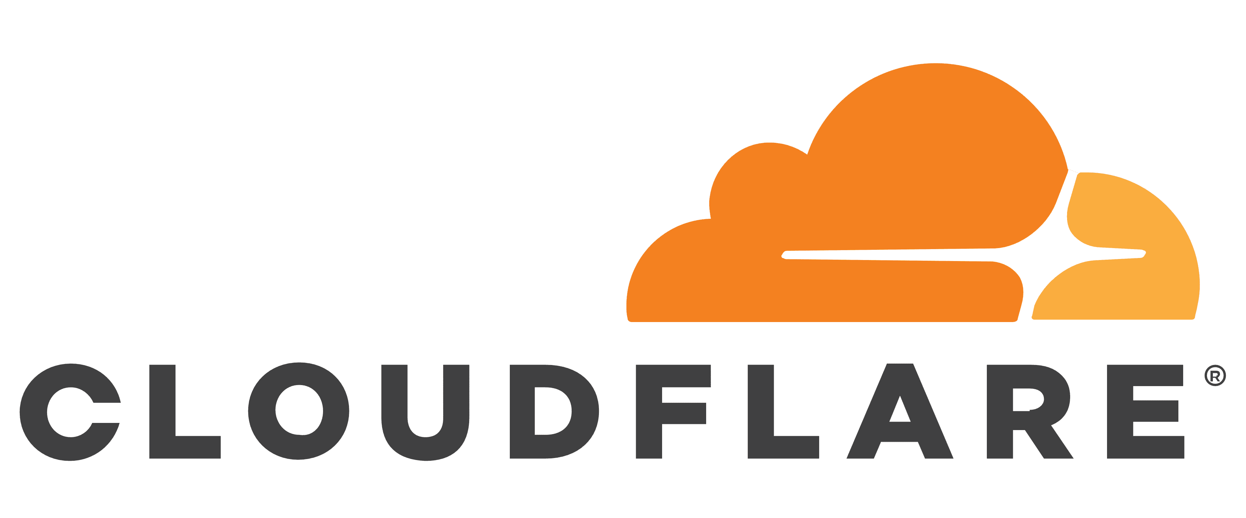


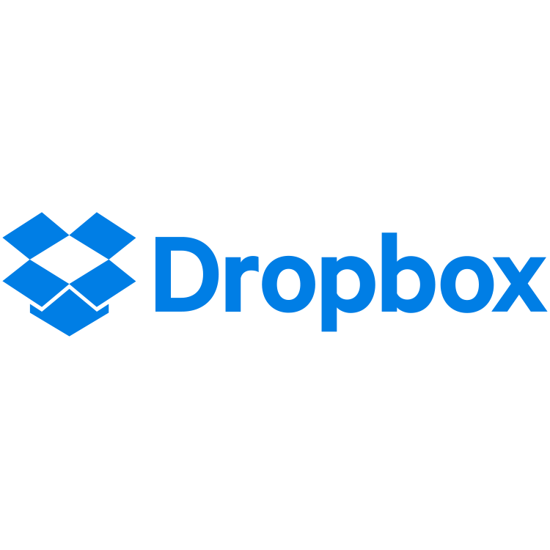
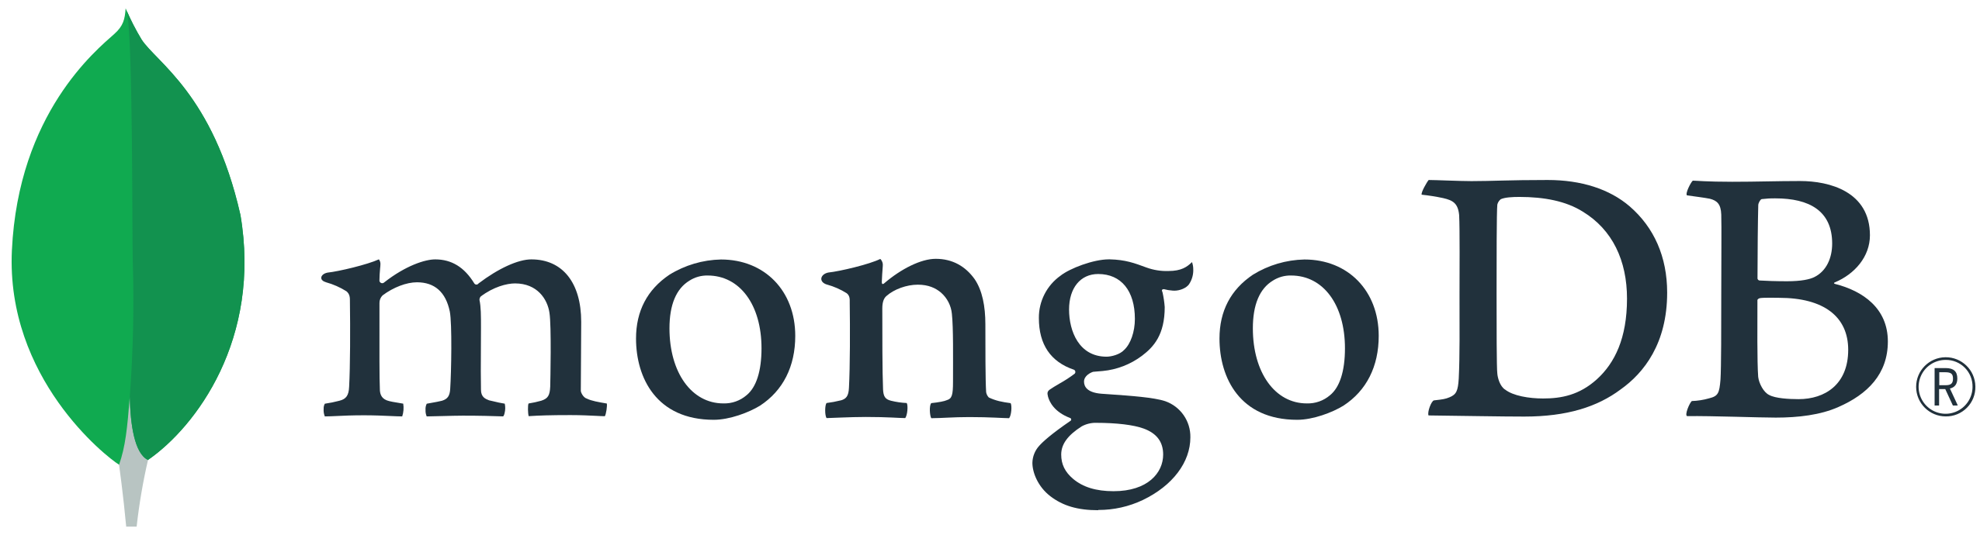







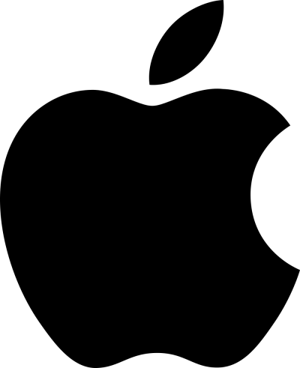
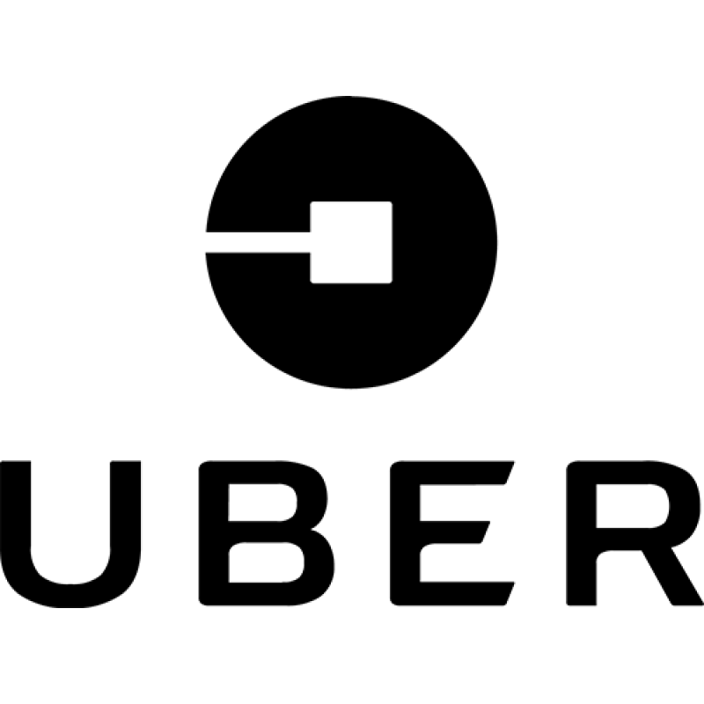
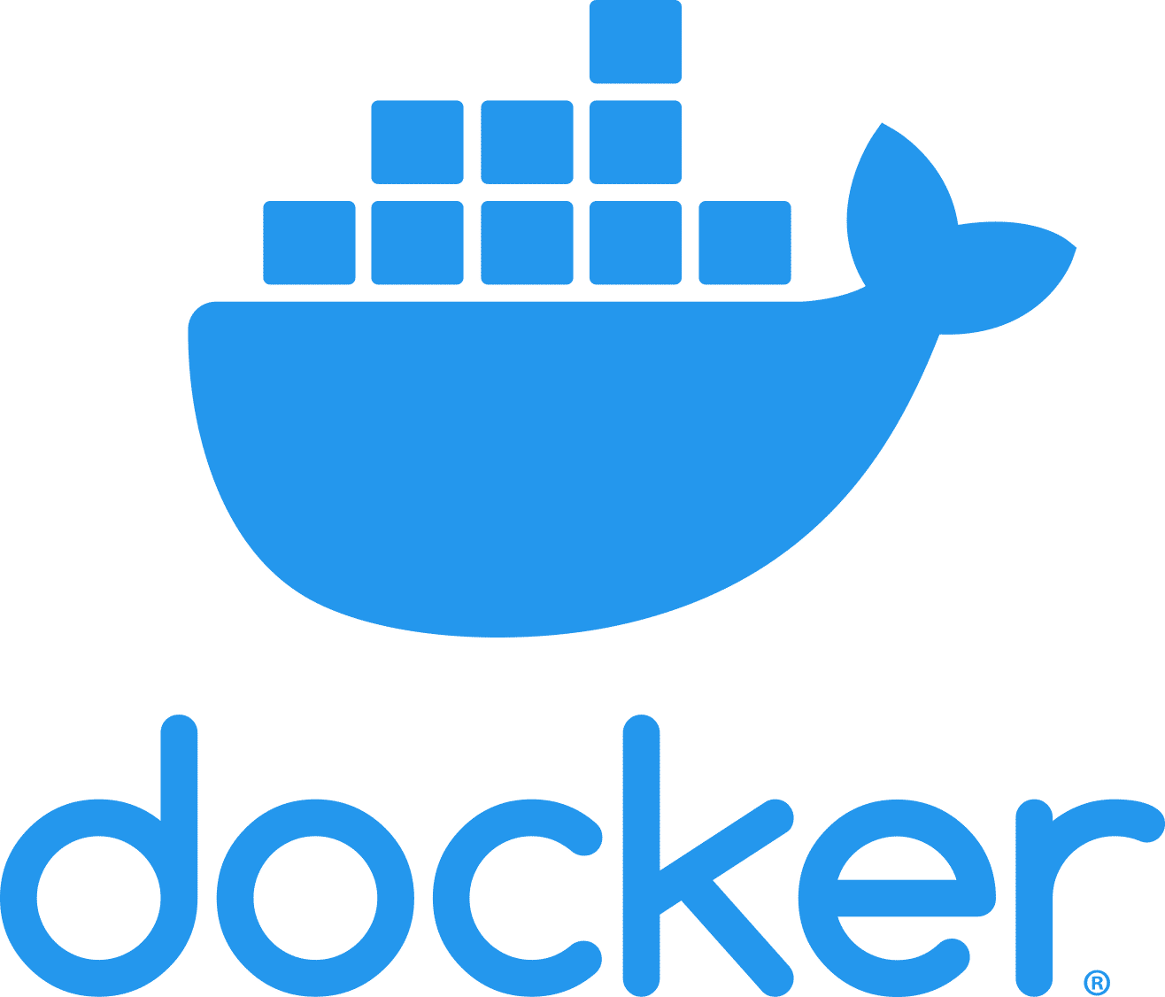
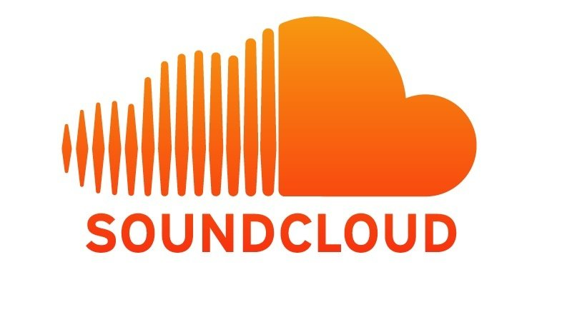


Top Companies uses Golang

Slide 9
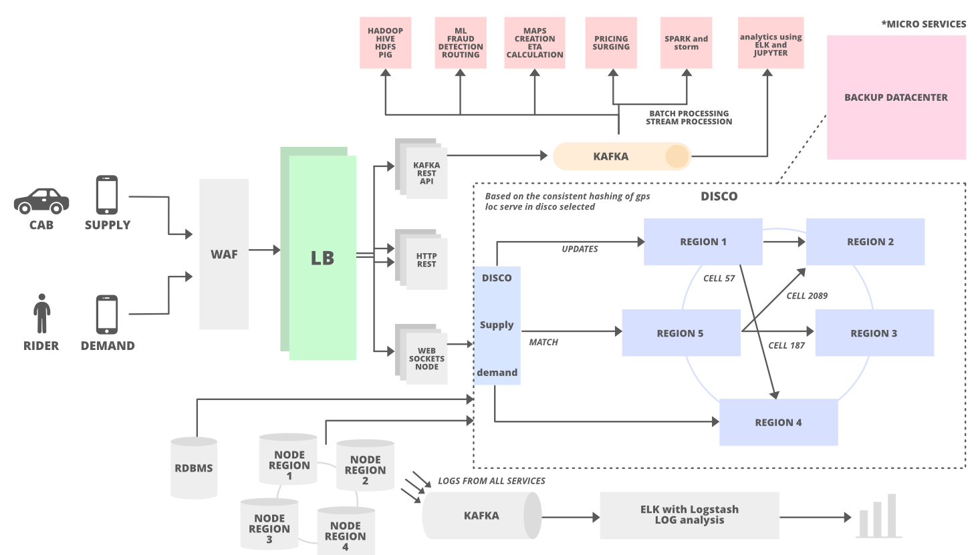
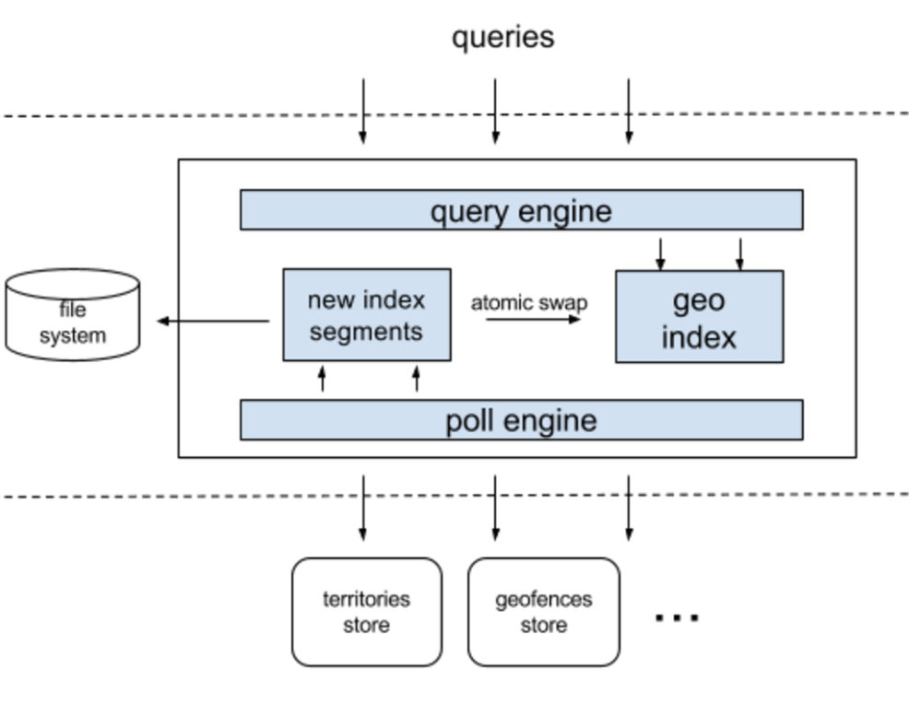
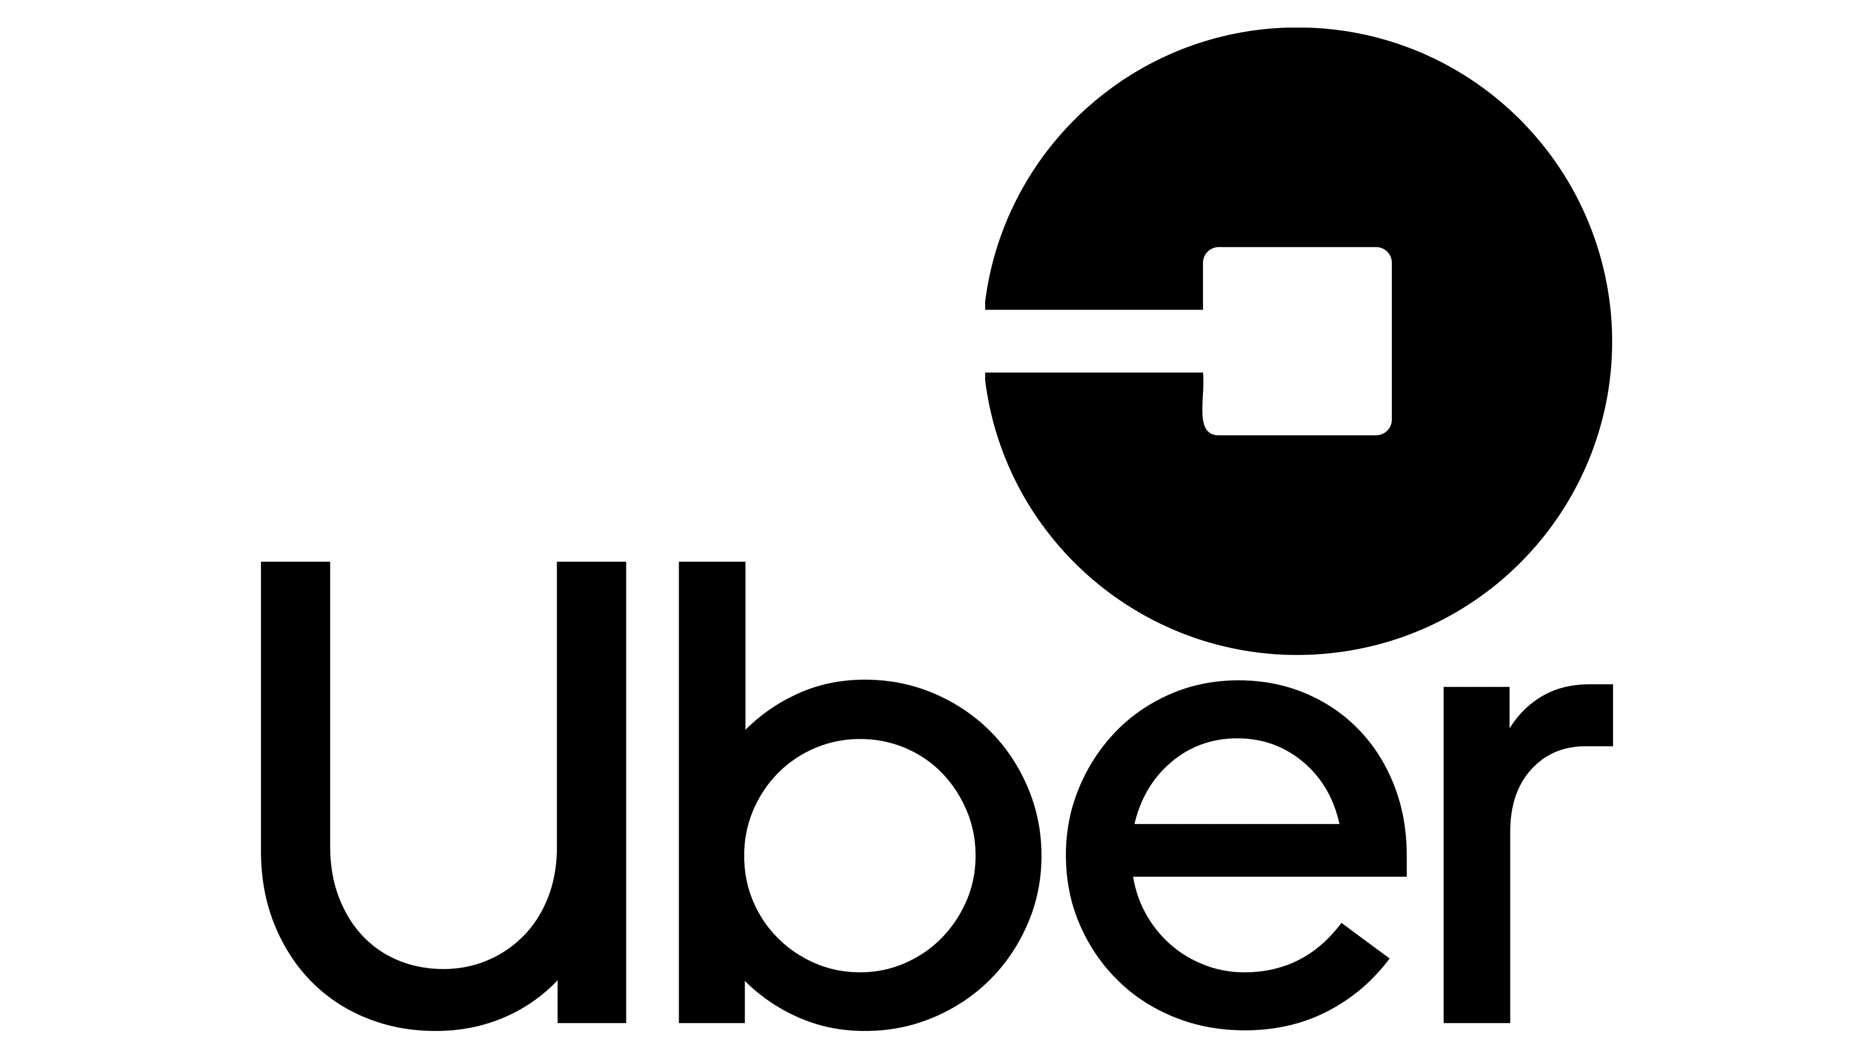
How & Where Uber using Golang
High-level architecture of Uber
Service architecture for geofence lookup
Reference : https://www.uber.com/en-IN/blog/go-geofence-highest-query-per-second-service/

Slide 10
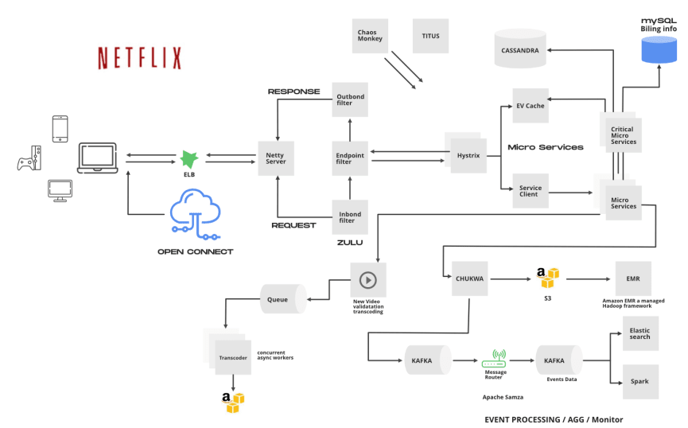
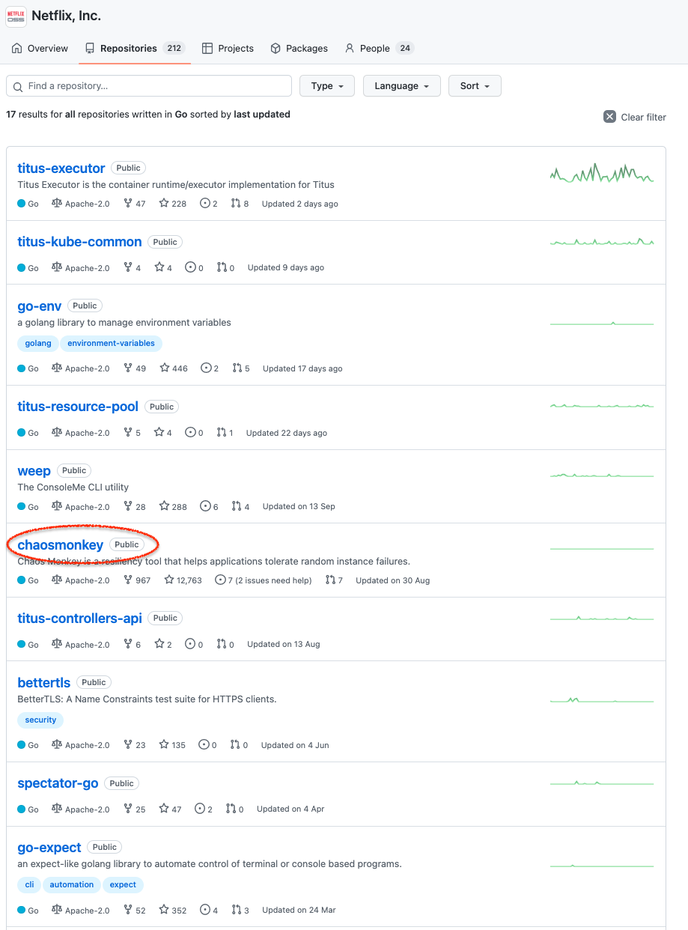
How & Where Netflix using Golang
Event Processing architecture of Netflix
Netflix Golang Opensource Tools/services
Fully integrated with Spinnaker and Support AWS, Google Compute Engine, Azure, Kubernetes, Cloud Foundry). It has been tested with AWS,GCE, and Kubernetes.
Reference : https://github.com/Netflix/chaosmonkey

Slide 11
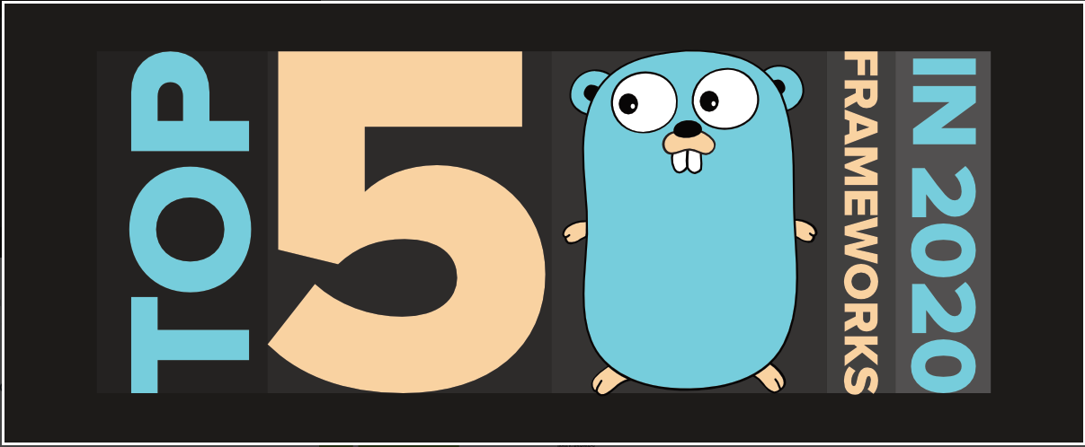
Golang Top Frameworks( as of 2022)
Gin
The gin framework tops the list of Go frameworks in terms of popularity due to its minimalist framework and performance. It is mostly used for building a REST API for the backend. The API of this web framework will be similar to that of martini but is close to 40 times faster than it!
Beego
The beego framework is used for the rapid development of REST APIs, web applications, and backend services in Golang. It is a full-fledged Model-View-Controller (MVC) framework with its own libraries and a built-in tool.
Echo
The echo framework used in Go is another high-performance, extensible, and minimalist web framework in Golang. It has a highly optimized HTTP router with zero dynamic memory allocation that smartly prioritizes routes. It automatically installs TLS certificates from Let’s Encrypt and provides HTTP/2 support.
Kit
The kit framework is a programming toolkit for building robust, reliable, and maintainable microservices in Golang. It is a set of packages and best practices, which provide a comprehensive, robust, and trustable way of building microservices for organizations of any size.
Fasthttp
The fasthttp framework provides a fast HTTP server and client API which was made as an alternative to net/http due to its limits on optimization opportunities. It is optimized for speed and can easily handle more than 100K qps and more than 1M concurrent keep-alive connections on modern hardware.
IN 2022
Name | Stars | Forks
gin | 40.2k | 4.6k
beego | 24.5k | 4.9k
echo | 17.7k | 1.6k
kit | 17.5k | 1.8k
fasthttp | 13k | 1.1k

Slide 12
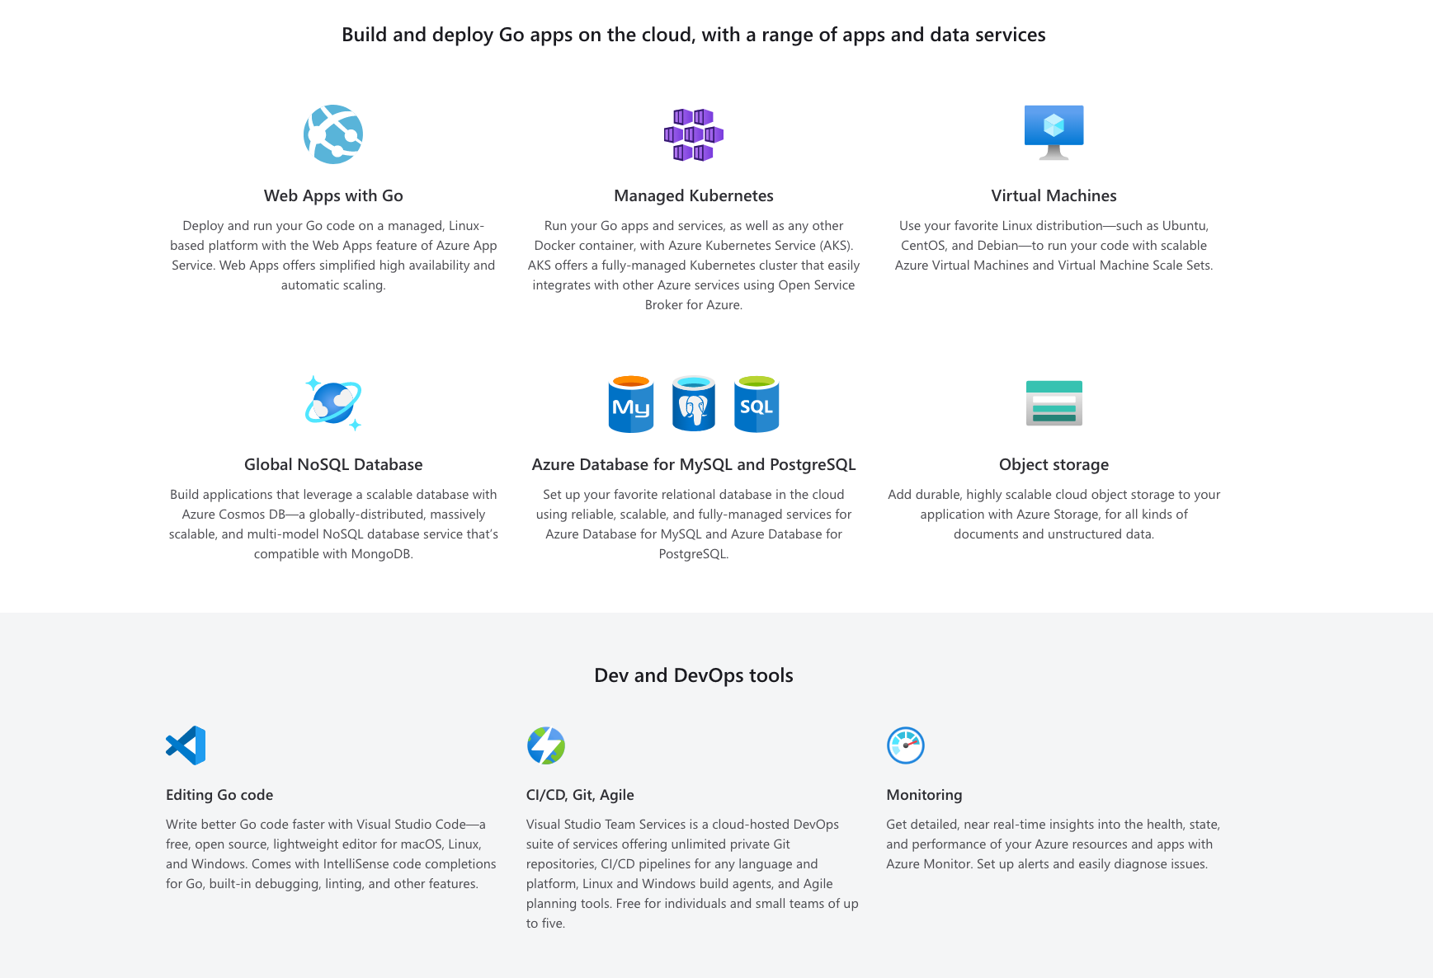
Key Azure services for Go developers

Slide 13
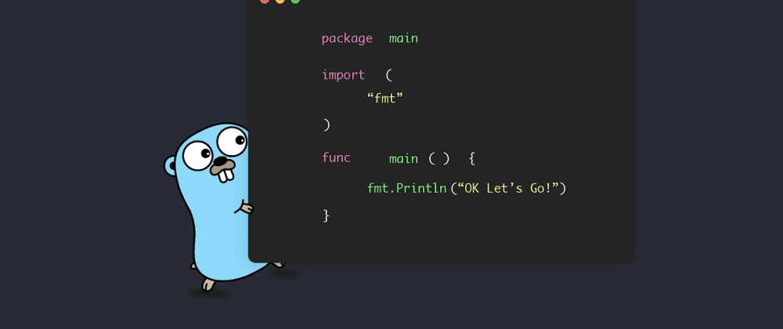
Let’s Go…

Slide 14
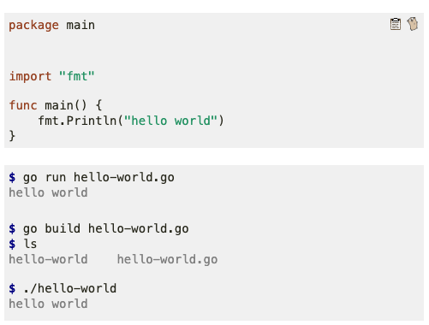
Run your first Golang App locally
To run the program, put the code in hello-world.go
use go run.
Sometimes we’ll want to build our programs into binaries.
We can do this using go build.
Then, execute the built binary directly.
That’s all, you did it ☺
If you want to try online compiler checkout ,
https://go.dev/play/

Slide 15
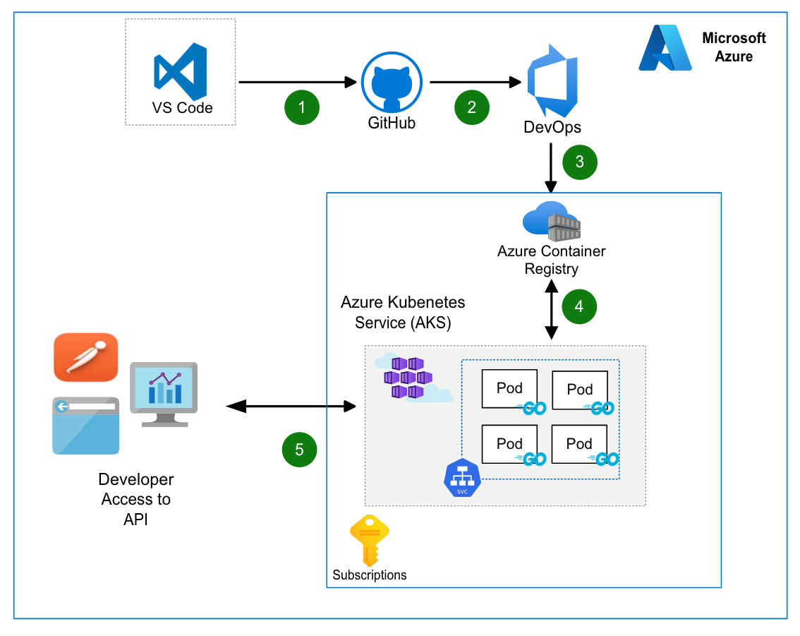
Demo – Deploy Golang App as Service on AKS

Slide 16
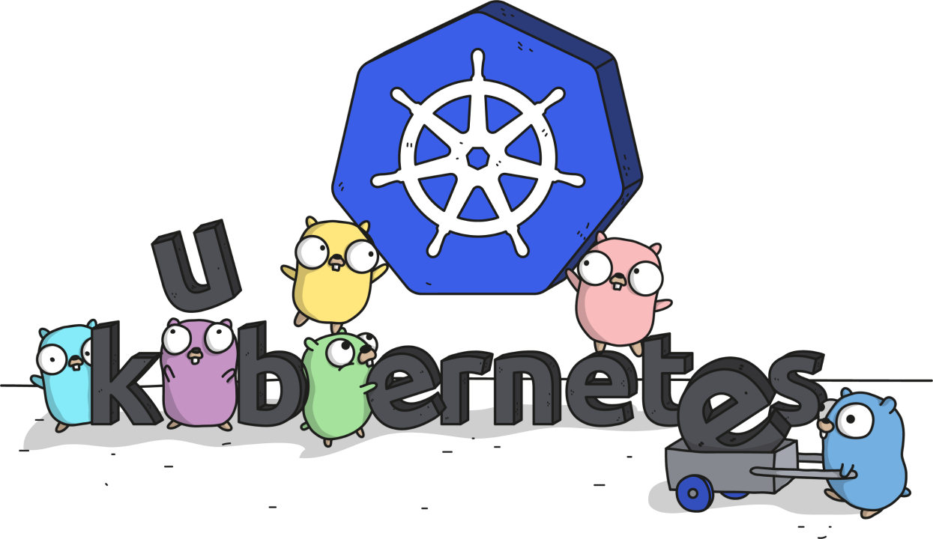
Demo – Deploy Golang App as Service on AKS
Hands-on : Create Simple Golang API App and deploy to Azure Kubernetes through Azure DevOps GitHub Source Code Link:
https://github.com/priyasundarsp/FirstGolangApp

Slide 17
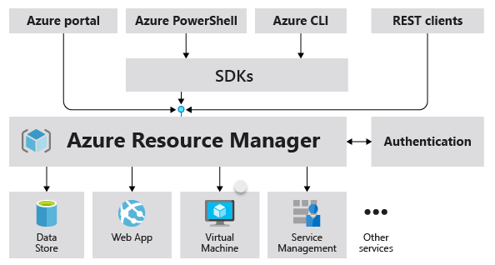
Overview of Azure Golang SDKs
Azure SDK for Go can help you create & manage Azure resources very quickly.
The Azure SDK for Go provides several libraries (grouped into management and client) that allow your Go code to communicate with Azure services.
Both the management and client libraries are designed to work with both local and cloud environments.
Due to the adoption of generics, the Azure SDK for Go is compatible with Go 1.18 and later.
Azure GoLang SDK
SDKs

Slide 18
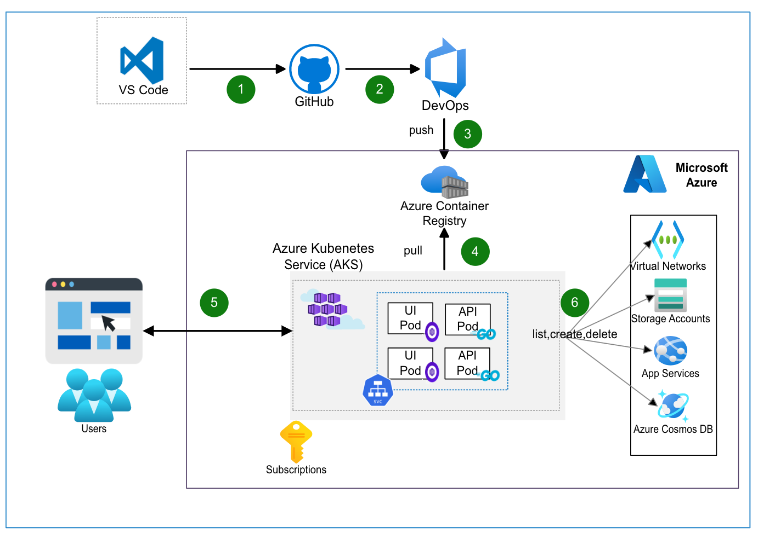
Demo – Simple UI App to provision Azure Service using Azure golang SDK

Slide 19
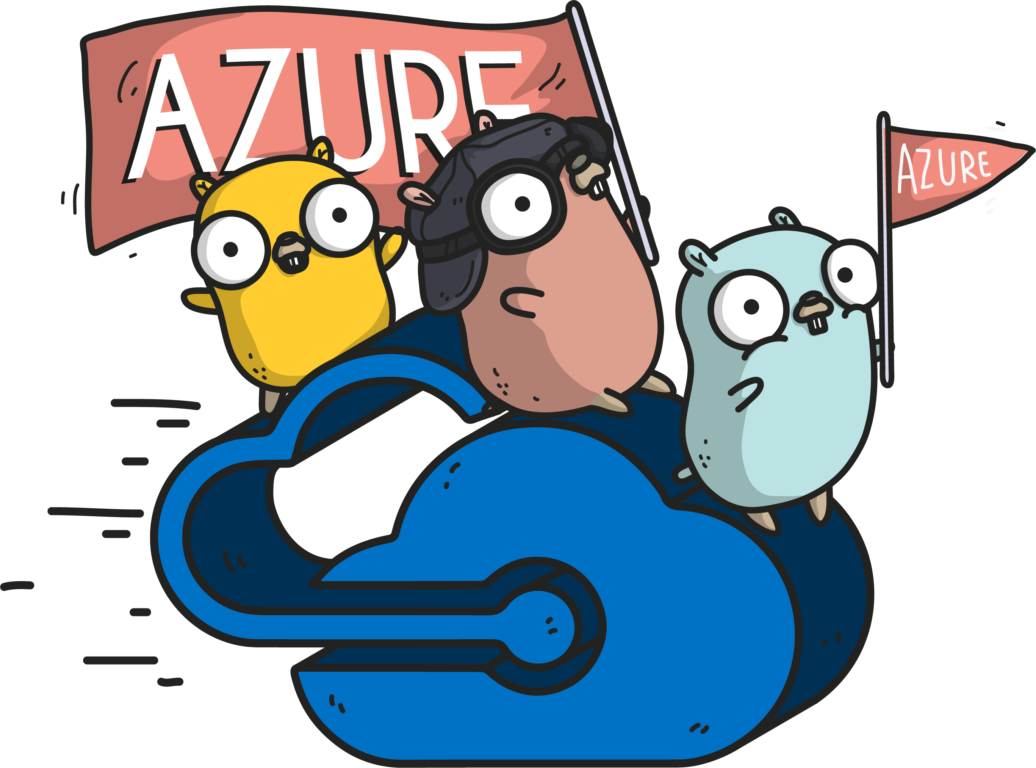
Demo- Simple UI App to provision Azure Service using Azure golang SDK
Hands-on : Simple Preact UI App to deploy azure services using Azure Golang SDK GitHub Source Code Link:
https://github.com/priyasundarsp/AzureGolangSDKApp

Slide 20
Reference
GitHub Code Repo for Example:
https://github.com/priyasundarsp/msdocs-go-webapp-quickstart
https://github.com/priyasundarsp/petstore-golang-sample
https://github.com/priyasundarsp/azure-sdk-for-go-samples
Reference Documents:
https://github.com/Azure/azure-sdk-for-go
https://learn.microsoft.com/en-us/azure/developer/go/management-libraries
https://learn.microsoft.com/en-gb/azure/developer/go/key-azure-services-for-go
https://learn.microsoft.com/en-us/azure/developer/go/
https://pkg.go.dev/github.com/ozzyz/azure-sdk-for-go

Slide 21

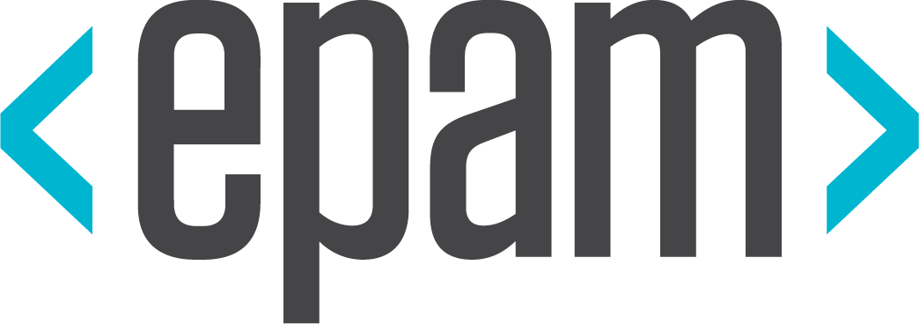


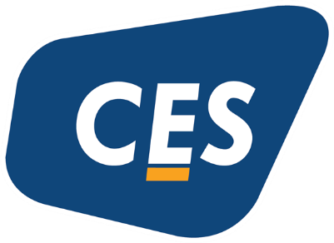
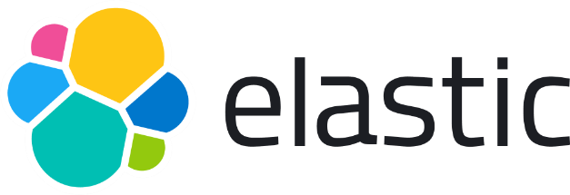
Platinum Partner
Gold Partner
Silver Partner

Slide 22
Q & A

Slide 23
Keep Learning & Keep Rocking ☺
Priyatharshini Sundaram
MCT ,Software Engineer 3
https://www.linkedin.com/in/priyatharshini-s-75b002110/

